Slide 1
Machine Independent Assembler Features

Slide 2
Today’s Topic
Section 2.3 of Beck’s “System Software” book -- Machine Independent Assembler Features
  Literals
  Symbol Defining Statements
  Expressions
  Program Blocks
  Control Sections and Program Linking

Slide 3
Literals
Design idea
  Let programmers write the value of a constant operand as a part of the instruction that uses it
  Avoid having to define the constant elsewhere in the program and make up a label for it
Example (Fig. 2.10)
  45 001A ENDFIL LDA =C’EOF’
  215 1062 WLOOP TD =X’05’

Slide 4
(Figure 2.9)
5 0000 COPY START 0
10 0000 FIRST STL RETADR 17202D
13 0003 LDB #LENGTH 69202D
14 BASE LENGTH
15 0006 CLOOP +JSUB RDREC 4B101036
20 000A LDA LENGTH 032026
25 000D COMP #0 290000
30 0010 JEQ ENDFIL 332007
35 0013 +JSUB WRREC 4B10105D
40 0017 J CLOOP 3F2FEC
45 001A ENDFIL LDA =C’EOF’ 032010
50 001D STA BUFFER 0F2016
55 0020 LDA #3 010003
60 0023 STA LENGTH 0F200D
65 0026 +JSUB WRREC 4B10105D
70 002A J @RETADR 3E2003
93 LTORG
95 0030 RETADR RESW 1
100 0033 LENGTH RESW 1
105 0036 BUFFER RESB 4096
106 1036 BUFEND EQU *
107 1000 MAXLEN EQU BUFEND - BUFFER

Slide 5
115 . READ RECORD INTO BUFFER
120 .
125 1036 RDREC CLEAR X B410
130 1038 CLEAR A B400
132 103A CLEAR S B440
133 103C +LDT #MAXLEN 75101000
135 1040 RLOOP TD INPUT E32019
140 1043 JEQ RLOOP 332FFA
145 1046 RD INPUT DB2013
150 1049 COMPR A,S A004
155 104B JEQ EXIT 332008
160 104E STCH BUFFER,X 57C003
165 1051 TIXR T B850
170 1053 JLT RLOOP 3B2FEA
175 1056 EXIT STX LENGTH 134000
180 1059 RSUB 4F0000
185 105C INPUT BYTE X’F1’ F1

Slide 6
195 .
200 . WRITE RECORD FROM BUFFER
205 .
210 105D WRREC CLEAR X B410
212 105F LDT LENGTH 774000
215 1062 WLOOP TD =X’05’ E32011
220 1065 JEQ WLOOP 332FFA
225 1068 LDCH BUFFER,X 53C003
230 106B WD =X’05’ DF2008
235 106E TIXR T B850
240 1070 JLT WLOOP 3B2FEF
245 1073 RSUB 4F0000
255 END FIRST

Slide 7
Literals vs. Immediate Operands
Immediate operands
  Operand value is assembled as part of the machine instruction
  55 0020 LDA #3 010003
Literals
  The assembler generates the specified value as a constant at some other memory location
  45 001A ENDFIL LDA =C’EOF’ 032010
Compare (Fig. 2.6)
  45 001A ENDFIL LDA EOF 032010
  80 002D EOF BYTE C’EOF’ 454F46

Slide 8
Literal - Implementation (1/3)
Literal pools
  Normally literals are placed into a pool at the end of the program
    See Fig. 2.10 (END statement)
  In some cases, it is desirable to place literals into a pool at some other location in object program
    Use assembler directive LTORG: create a literal pool that contains all of the literal operands used since the previous LTROG, and place it where LTORG was encountered
    Reason: keep literal operand close to the instruction

Slide 9
(Figure 2.10)
5 0000 COPY START 0
10 0000 FIRST STL RETADR 17202D
13 0003 LDB #LENGTH 69202D
14 BASE LENGTH
15 0006 CLOOP +JSUB RDREC 4B101036
20 000A LDA LENGTH 032026
25 000D COMP #0 290000
30 0010 JEQ ENDFIL 332007
35 0013 +JSUB WRREC 4B10105D
40 0017 J CLOOP 3F2FEC
45 001A ENDFIL LDA =C’EOF’ 032010
50 001D STA BUFFER 0F2016
55 0020 LDA #3 010003
60 0023 STA LENGTH 0F200D
65 0026 +JSUB WRREC 4B10105D
70 002A J @RETADR 3E2003
93 LTORG
002D * =C’EOF’ 454F46
95 0030 RETADR RESW 1
100 0033 LENGTH RESW 1
105 0036 BUFFER RESB 4096
106 1036 BUFEND EQU *
107 1000 MAXLEN EQU BUFEND - BUFFER

Slide 10
115 . READ RECORD INTO BUFFER
120 .
125 1036 RDREC CLEAR X B410
130 1038 CLEAR A B400
132 103A CLEAR S B440
133 103C +LDT #MAXLEN 75101000
135 1040 RLOOP TD INPUT E32019
140 1043 JEQ RLOOP 332FFA
145 1046 RD INPUT DB2013
150 1049 COMPR A,S A004
155 104B JEQ EXIT 332008
160 104E STCH BUFFER,X 57C003
165 1051 TIXR T B850
170 1053 JLT RLOOP 3B2FEA
175 1056 EXIT STX LENGTH 134000
180 1059 RSUB 4F0000
185 105C INPUT BYTE X’F1’ F1

Slide 11
195 .
200 . WRITE RECORD FROM BUFFER
205 .
210 105D WRREC CLEAR X B410
212 105F LDT LENGTH 774000
215 1062 WLOOP TD =X’05’ E32011
220 1065 JEQ WLOOP 332FFA
225 1068 LDCH BUFFER,X 53C003
230 106B WD =X’05’ DF2008
235 106E TIXR T B850
240 1070 JLT WLOOP 3B2FEF
245 1073 RSUB 4F0000
255 END FIRST
1076 * =X’05’ 05

Slide 12
Literal - Implementation (2/3)
Duplicate literals
  215 1062 WLOOP TD =X’05’
  230 106B WD =X’05’
Assembler should recognize duplicate literals and store only one copy of specified data value
  By comparing defining character string, e.g. =X’05’
  By comparing the generated data value, e.g. =C’EOF’ and =X’454F46’, but benefits are usually not great enough to justify the additional complexity in the assembler

Slide 13
Literal - Implementation (3/3)
Use LITTAB:
  Literal name, operand value & length, operand address
Pass 1
  Build LITTAB with literal name, operand value/length
  When LTORG is encountered, assign address to each literal not yet assigned an address, update LOCCTR
Pass 2
  Search LITTAB for each literal encountered and generate the operand address
  Data values of literals in literal pool are generated similarly as using BYTE or WORD statements
  Generate modification record for literals that represent an address in the program

Slide 14
Today’s Topic
Section 2.3 of Beck’s “System Software” book -- Machine Independent Assembler Features
  Literals
  Symbol Defining Statements
  Expressions
  Program Blocks
  Control Sections and Program Linking

Slide 15
Symbol-Defining Statements (1/2)
Users can define labels on instructions or data areas
  The value of a label is the address assigned to the statement
Users can also define symbols with values
  symbol EQU value
  value can be constants, other symbols, expressions
  Making source program easier to understand
  No forward reference

Slide 16
Symbol-Defining Statements (2/2)
Example 1:
  MAXLEN EQU 4096
  133 +LDT #MAXLEN
Example 2:
  BASE EQU R1
  COUNT EQU R2
  INDEX EQU R3
Example 3:
  MAXLEN EQU BUFEND-BUFFER
  +LDT #4096

Slide 17
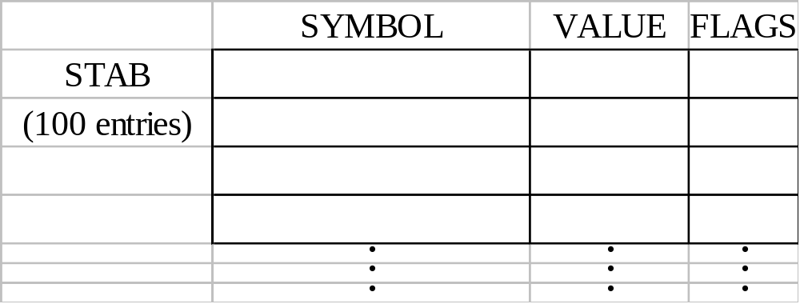
ORG (origin)
Indirectly assign values to symbols
Reset the location counter to the specified value
    ORG value
Value can be:  constant,  other symbol,  expression
No forward reference
Example
  SYMBOL: 6bytes
  VALUE: 1word
  FLAGS: 2bytes
  LDA VALUE, X
Chap 2

Slide 18
ORG Example
Using EQU statements
  STAB RESB 1100
  SYMBOL EQU STAB
  VALUE EQU STAB+6
  FLAG EQU STAB+9
Using ORG statements
  STAB RESB 1100
  ORG STAB
  SYMBOL RESB 6
  VALUE RESW 1
  FLAGS RESB 2
  ORG STAB+1100
Chap 2

Slide 19
Today’s Topic
Section 2.3 of Beck’s “System Software” book -- Machine Independent Assembler Features
  Literals
  Symbol Defining Statements
  Expressions
  Program Blocks
  Control Sections and Program Linking

Slide 20
Expressions (1/2)
Expressions are evaluated by assembler to produce a single operand address or value
Absolute or relative expressions
  MAXLEN EQU BUFEND-BUFFER
  BUFEND and BUFFER are relative terms, representing addresses relative to program beginning → change with program start address
  But, BUFEND−BUFFER has absolute value
    When relative terms are paired with opposite signs, the dependency on starting address is canceled out; the result is an absolute value

Slide 21
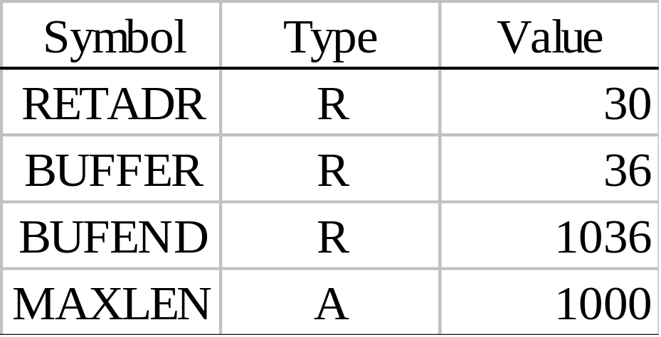
Expressions (2/2)
No relative terms may enter into a multiplication or division operation; the followings are errors:
  BUFEND+BUFFER, 100-BUFFER, 3*BUFFER
Assembler needs to track type of an expression, to generate Modification records if needed
  Can add one flag in SYMTAB

Slide 22
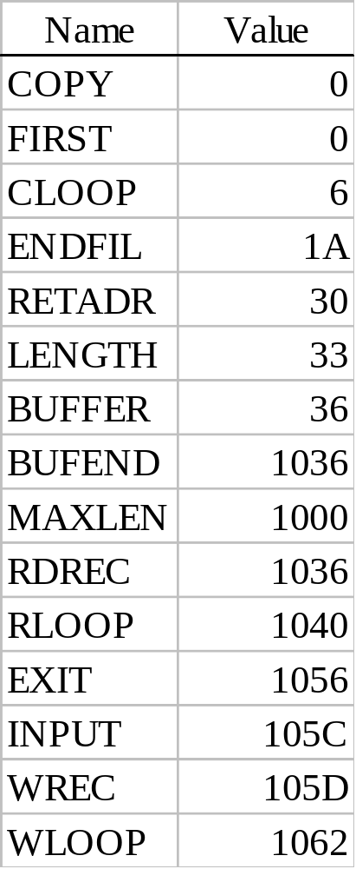
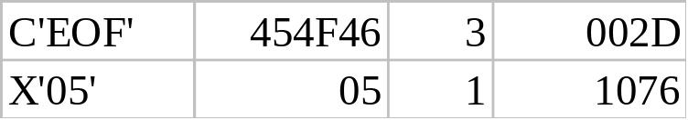
Example 2.9
SYMTAB LITTAB
Chap 2

Slide 23
Today’s Topic
Section 2.3 of Beck’s “System Software” book -- Machine Independent Assembler Features
  Literals
  Symbol Defining Statements
  Expressions
  Program Blocks
  Control Sections and Program Linking

Slide 24
Program Blocks
Program blocks
  Refer to segments of code that are rearranged within a single object program unit
  USE [blockname]
  Assembler will rearrange these segments to put together all source lines belonging to a block
  At the beginning, statements are assumed to be part of the unnamed (default) block
    If no USE statements are included, the entire program belongs to this single block

Slide 25
(Figure 2.11)
Line Source statement
5 0000 0 COPY START 0
10 0000 0 FIRST STL RETADR 17202D
15 0003 0 CLOOP JSUB RDREC 4B2021
20 0006 0 LDA LENGTH 032026
25 0009 0 COMP #0 290000
30 000C 0 JEQ ENDFIL 332006
35 000F 0 JSUB WRREC 4B203B
40 0012 0 J CLOOP 3F2FEE
45 0015 0 ENDFIL LDA =C’EOF’ 032055
50 0018 0 STA BUFFER 0F2056
55 001B 0 LDA #3 010003
60 001E 0 STA LENGTH 0F2048
65 0021 0 JSUB WRREC 4B2029
70 0024 0 J @RETADR 3E203F
92 0000 1 USE CDATA
95 0000 1 RETADR RESW 1
100 0003 1 LENGTH RESW 1
103 0000 2 USE CBLKS
105 0000 2 BUFFER RESB 4096
106 1000 2 BUFEND EQU *
107 1000 MAXLEN EQU BUFEND - BUFFER
3 blocks:
Default (0)
CDATA (1)
CBLKS (2)

Slide 26
115 . READ RECORD INTO BUFFER
120 .
123 0027 0 USE
125 0027 0 RDREC CLEAR X B410
130 0029 0 CLEAR A B400
132 002B 0 CLEAR S B440
133 002D 0 +LDT #MAXLEN 75101000
135 0031 0 RLOOP TD INPUT E32038
140 0034 0 JEQ RLOOP 332FFA
145 0037 0 RD INPUT DB2032
150 003A 0 COMPR A,S A004
155 003C 0 JEQ EXIT 332008
160 003F 0 STCH BUFFER,X 57A02F
165 0042 0 TIXR T B850
170 0044 0 JLT RLOOP 3B2FEA
175 0047 0 EXIT STX LENGTH 13201F
180 004A 0 RSUB 4F0000
183 0006 1 USE CDATA
185 0006 1 INPUT BYTE X’F1’ F1

Slide 27
195 .
200 . WRITE RECORD FROM BUFFER
205 .
208 004D 0 USE
210 004D 0 WRREC CLEAR X B410
212 004F 0 LDT LENGTH 772017
215 0052 0 WLOOP TD =X’05’ E3201B
220 0055 0 JEQ WLOOP 332FFA
225 0058 0 LDCH BUFFER,X 53A016
230 005B 0 WD =X’05’ DF2012
235 005E 0 TIXR T B850
240 0060 0 JLT WLOOP 3B2FEF
245 0063 0 RSUB 4F0000
252 0007 1 USE CDATA
253 LTORG
0007 1 * =C’EOF’ 454F46
000A 1 * =X’05’ 05
255 END FIRST

Slide 28
Program Blocks - Implementation
Pass 1
  Each program block has a separate location counter
  Each label is assigned an address that is relative to the start of the block that contains it
  At end of Pass 1, last value of the location counter for each block indicates the length of that block
  The assembler can then assign to each block a starting address in the object program
Pass 2
  The address of each symbol can be computed by adding the assigned block starting address and the relative address of the symbol to that block

Slide 29
(Figure 2.12)
Line Loc/Block Source statement Object code
5 0000 0 COPY START 0
10 0000 0 FIRST STL RETADR 17202D
15 0003 0 CLOOP JSUB RDREC 4B2021
20 0006 0 LDA LENGTH 032060
25 0009 0 COMP #0 290000
30 000C 0 JEQ ENDFIL 332006
35 000F 0 JSUB WRREC 4B203B
40 0012 0 J CLOOP 3F2FEE
45 0015 0 ENDFIL LDA =C’EOF’ 032055
50 0018 0 STA BUFFER 0F2056
55 001B 0 LDA #3 010003
60 001E 0 STA LENGTH 0F2048
65 0021 0 JSUB WRREC 4B2029
70 0024 0 J @RETADR 3E203F
92 0000 1 USE CDATA
95 0000 1 RETADR RESW 1
100 0003 1 LENGTH RESW 1
103 0000 2 USE CBLKS
105 0000 2 BUFFER RESB 4096
106 1000 2 BUFEND EQU *
107 1000 MAXLEN EQU BUFEND - BUFFER

Slide 30
115 . READ RECORD INTO BUFFER
120 .
123 0027 0 USE
125 0027 0 RDREC CLEAR X B410
130 0029 0 CLEAR A B400
132 002B 0 CLEAR S B440
133 002D 0 +LDT #MAXLEN 75101000
135 0031 0 RLOOP TD INPUT E32038
140 0034 0 JEQ RLOOP 332FFA
145 0037 0 RD INPUT DB2032
150 003A 0 COMPR A,S A004
155 003C 0 JEQ EXIT 332008
160 003F 0 STCH BUFFER,X 57A02F
165 0042 0 TIXR T B850
170 0044 0 JLT RLOOP 3B2FEA
175 0047 0 EXIT STX LENGTH 13201F
180 004A 0 RSUB 4F0000
183 0006 1 USE CDATA
185 0006 1 INPUT BYTE X’F1’ F1

Slide 31
195 .
200 . WRITE RECORD FROM BUFFER
205 .
208 004D 0 USE
210 004D 0 WRREC CLEAR X B410
212 004F 0 LDT LENGTH 772017
215 0052 0 WLOOP TD =X’05’ E3201B
220 0055 0 JEQ WLOOP 332FFA
225 0058 0 LDCH BUFFER,X 53A016
230 005B 0 WD =X’05’ DF2012
235 005E 0 TIXR T B850
240 0060 0 JLT WLOOP 3B2FEF
245 0063 0 RSUB 4F0000
252 0007 1 USE CDATA
253 LTORG
0007 1 * =C’EOF’ 454F46
000A 1 * =X’05’ 05
255 END FIRST

Slide 32
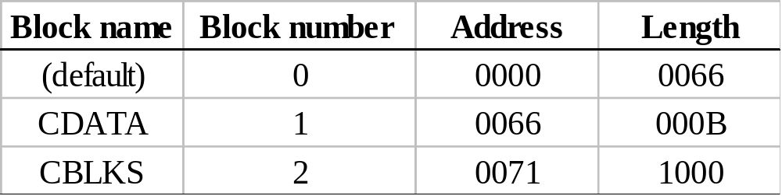
Figure 2.12
Each source line is given a relative address and a block number
Absolute symbol has no block number (line 107)
  20 0006 0 LDA LENGTH 032060
  LENGTH = (Block 1) + 0003 = 0066 + 0003 = 0069
  LOCCTR = (Block 0) + 0009 = 0009
  Displacement = 0069 – 0009 = 060

Slide 33
Program Readability
Program readability
  No extended format instructions (lines 15, 35, 65)
  No need for base relative addressing (line 13, 14)
  LTORG is used to make sure the literals are placed ahead of any large data areas (line 253)
Object code
  It is not necessary to physically rearrange the generated code in the object program; loader can handle it
  See Fig. 2.13, Fig. 2.14

Slide 34
Figure 2.13
H COPY 000000 001071
T 000000 1E 172063 4B2021 032060 290000 332006 4B203B ...
T 00001E 09 0F2048 4B2029 3E203F
T 000027 1D B410 B400 B440 75101000 E32038 332FFA …
T 000044 09 3B2FEA 13201F 4F0000
T 00006C 01 F1
T 00004D 19 B410 772017 E3201B 332FFA 53A016 DF2012 …
T 00006D 04 454F46 05
E 000000
CDATA

Slide 35
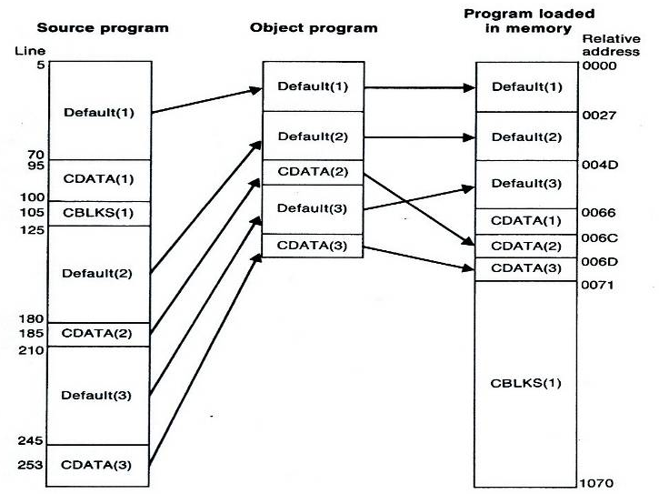
Figure 2.14

Slide 36
Today’s Topic
Section 2.3 of Beck’s “System Software” book -- Machine Independent Assembler Features
  Literals
  Symbol Defining Statements
  Expressions
  Program Blocks
  Control Sections and Program Linking

Slide 37
Control Sections & Code Linking
Control sections
  Most often used for subroutines or other logical subdivisions of a program
  Programmer can assemble, manipulate, and load each of these control sections separately
  Instructions in one control section may need to refer to instructions or data in another section
  Thus, there should be some means for linking control sections together
  Fig. 2.15, 2.16: three control sections (COPY, RDREC, WRREC)

Slide 38
(Figure 2.16)
5 0000 COPY START 0
6 EXTDEF BUFFER,BUFEND,LENGTH
7 EXTREF RDREC,WRREC
10 0000 FIRST STL RETADR 172027
15 0003 CLOOP +JSUB RDREC 4B100000
20 0007 LDA LENGTH 032023
25 000A COMP #0 290000
30 000D JEQ ENDFIL 332007
35 0010 +JSUB WRREC 4B100000
40 0014 J CLOOP 3F2FEC
45 0017 ENDFIL LDA =C’EOF’ 032016
50 001A STA BUFFER 0F2016
55 001D LDA #3 010003
60 0020 STA LENGTH 0F200A
65 0023 +JSUB WRREC 4B100000
70 0027 J @RETADR 3E2000
95 002A RETADR RESW 1
100 002D LENGTH RESW 1
103 LTORG
0030 * =C’EOF’ 454F46
105 0033 BUFFER RESB 4096
106 1033 BUFEND EQU *
107 1000 MAXLEN EQU BUFEND - BUFFER

Slide 39
109 0000 RDREC CSECT
115 . READ RECORD INTO BUFFER
120 .
122 EXTREF BUFFER,LENGTH,BUFEND
125 0000 CLEAR X B410
130 0002 CLEAR A B400
132 0004 CLEAR S B440
133 0006 LDT MAXLEN 77201F
135 0009 RLOOP TD INPUT E3201B
140 000C JEQ RLOOP 332FFA
145 000F RD INPUT DB2015
150 0012 COMPR A,S A004
155 0014 JEQ EXIT 332009
160 0017 +STCH BUFFER,X 57900000
165 001B TIXR T B850
170 001D JLT RLOOP 3B2FE9
175 0020 EXIT +STX LENGTH 13100000
180 0024 RSUB 4F0000
185 0027 INPUT BYTE X’F1’ F1
190 0028 MAXLEN WORD BUFEND – BUFFER 000000

Slide 40
193 0000 WRREC CSECT
195 .
200 . WRITE RECORD FROM BUFFER
205 .
207 EXTREF LENGTH,BUFFER
210 0000 CLEAR X B410
212 0002 +LDT LENGTH 77100000
215 0006 WLOOP TD =X’05’ E32012
220 0009 JEQ WLOOP 332FFA
225 000C +LDCH BUFFER,X 53900000
230 0010 WD =X’05’ DF2008
235 0013 TIXR T B850
240 0015 JLT WLOOP 3B2FEF
245 0018 RSUB 4F0000
255 END FIRST
001B * =X’05’ 05

Slide 41
External Definition & References
External definition
  EXTDEF name [, name]
  Declare symbols that are defined in this control section and used by other sections
External reference
  EXTREF name [,name]
  Declare symbols that are used in this control section and are defined elsewhere
For EXTREF labels, assembler has no idea where the corresponding control section will be loaded → use 0
  15 0003 CLOOP +JSUB RDREC 4B100000
  160 0017 +STCH BUFFER,X 57900000
  190 0028 MAXLEN WORD BUFEND-BUFFER 000000

Slide 42
Implementation
Assembler must include information in object program that will cause loader to insert proper values where required
Define record
  Col. 1 D
  Col. 2-7 Name of external symbol defined in this control
  section
  Col. 8-13 Relative address within this control section (hex)
  Col.14-73 Repeat info in Col. 2-13 for other external symbols
Refer record
  Col. 1 R
  Col. 2-7 Name of external symbol referred to in this section
  Col. 8-73 Name of other external reference symbols

Slide 43
Modification Record
Modification record
  Col. 1 M
  Col. 2-7 Starting address of the field to be modified (hex)
  Col. 8-9 Length of the field to be modified, in half-bytes (hex)
  Col.11-16 External symbol whose value is to be added to or subtracted from the indicated field
  Note: control section name is automatically an external symbol, i.e. it is available for use in Modification records.
Example
  Figure 2.17
  M00000405+RDREC
  M00000705+COPY

Slide 44
Figure 2.17 (1/2)
H COPY 000000 001033
D BUFFER 00033 BUFEND 001033 LENGTH 00002D
R RDREC WRREC
T 000000 1D 172027 4B100000 032023 290000 332007 4B100000 ...
T 00001D 0D 010003 0F200A 4B10000 3E2000
T 000030 03 454F46
M 000004 05+RDREC
M 000011 05+WRREC
M 000024 05+WRREC
E 000000

Slide 45
Figure 2.17 (2/2)
H RDREC 000000 00002B
R BUFFER LENGTH BUFEND
T 000000 1D B410 B400 B440 77201F E3201B 332FFA DB2015 ...
T 00001D 0E 3B2FE9 13100000 4F0000 F1 000000
M 000018 05+BUFFER
M 000021 05+LENGTH
M 000028 06+BUFEND
M 000028 06-BUFFER
E
H WRREC 000000 00001C
R LENGTH BUFFER
T 000000 1C B410 77100000 E32012 332FFA 53900000 DF2008 ...
M 000003 05+LENGTH
M 00000D 05+BUFFER
E
190 MAXLEN WORD BUFEND - BUFFER

Slide 46
External Reference in Expression
Earlier definitions
  Required all of the relative terms be paired in an expression (an absolute expression), or that all except one be paired (a relative expression)
New restriction
  Both terms in each pair must be relative within the same control section
  Ex: BUFEND-BUFFER
  Ex: RDREC-COPY
In general, assembler cannot determine whether or not the expression is legal at assembly time. This work will be handled by a linking loader.

